Slide 1
Cybersecurity and Cyber Threats
KEY LOGGER and its solution
( The VIRTUAL KEYBOARD )
Understanding the Digital Battlefield
Nikhil Verma
Mohd Hamdan tahir
Mohit kumar
Galgotias college of engineering and technology

Slide 2

What is Cybersecurity?
Definition
Purpose
Protecting systems, networks, and programs from digital attacks.
Prevent unauthorized access, damage, or theft of data and systems.
Importance
Critical in safeguarding information in the modern digital world.

Slide 3
Types of Cyber Threats
Malware
Ransomware
Insider Threats
Includes viruses, worms, Trojans; Gafgyt infected 1.7M devices in 2023.
Encrypts data, demands ransom; $30B in damages reported in 2023.
Employees or contractors cause 34% of data breaches.
Phishing
DDoS Attacks
Deceptive emails and fake websites; 91% of attacks start with phishing.
Overwhelm systems with traffic; incidents rose 151% last year.

Slide 4
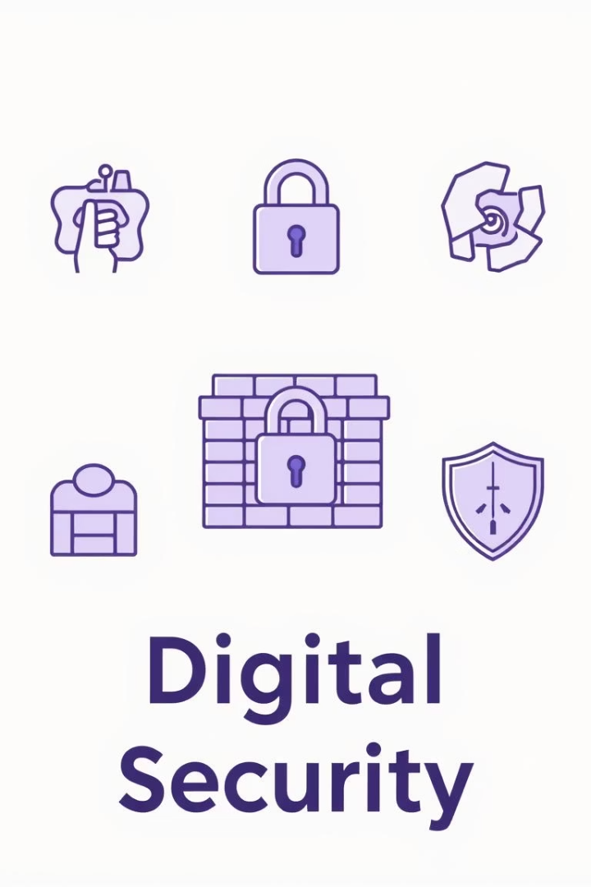
Prevention Methods
Firewalls
Monitor traffic and block 99% of common cyber attacks.
Antivirus Software
Detects and removes malware with 99.9% accuracy.
Multi-Factor Authentication
Reduces account compromises by 99% using multiple verification steps.
Employee Training
Educating staff cuts phishing success rates by 70%.

Slide 5

Case Studies: Notable Cyber Attacks
Target (2013)
40M credit cards stolen, $162M costs
WannaCry (2017)
Ransomware hit 150 countries, $4B+ damages
Equifax (2017)
147M personal records breached, $700M settlement
SolarWinds (2020)
Supply chain attack affecting 18,000 clients
Colonial Pipeline (2021)
Ransomware caused fuel shortage, $5M ransom paid

Slide 6




Future of Cybersecurity
AI & Machine Learning
Quantum Computing
1
Enhances threat detection with 90% accuracy.
Drives new encryption standards by 2024.
2
Zero Trust Architecture
4
IoT Security
Verifies every access, cutting breach radius by 90%.
3
Secures over 50 billion connected devices by 2030.

Slide 7


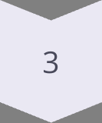
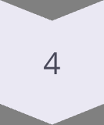
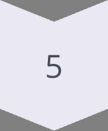
Emerging Cyber Threats
AI-Powered Attacks
Deepfakes used in sophisticated phishing scams.
Supply Chain Vulnerabilities
Exploitation through software dependencies and vendors.
Critical Infrastructure Attacks
Targets include water, power, and healthcare systems.
Misinformation Campaigns
Manipulating public opinion through false information.
Advanced Ransomware Tactics
Use double extortion and data leaks to pressure victims.

Slide 8
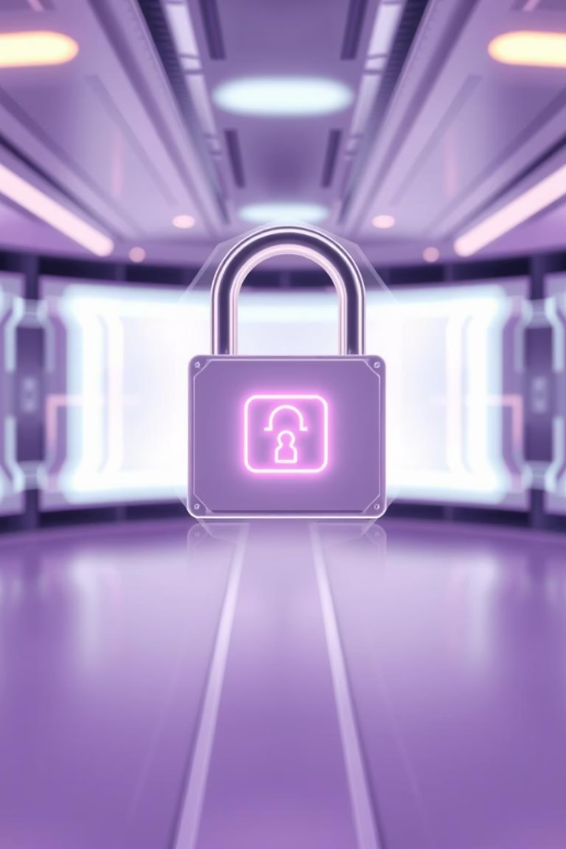
Conclusion
Essential Protection
Cybersecurity safeguards critical digital assets.
Stay Informed
Threat landscape is constantly evolving.
Proactive Measures
Reduce risks through prevention and awareness.
Continuous Improvement
Adapt defenses to emerging challenges regularly.

